Slide 1
MODULE 02: MEDICAL EQUIPMENT
TCCC TIER 1
All Service Members
TCCC TIER 2
Combat Lifesaver
TCCC TIER 3
Combat Medic/Corpsman
TCCC TIER 4
Combat Paramedic/Provider

Slide 2




TACTICAL COMBAT CASUALTY CARE (TCCC) ROLE-BASED TRAINING SPECTRUM
ROLE 1 CARE
NONMEDICAL PERSONNEL
MEDICAL PERSONNEL
ASM
CMC
CPP
CLS
YOU ARE HERE
STANDARDIZED JOINT CURRICULUM

Slide 3
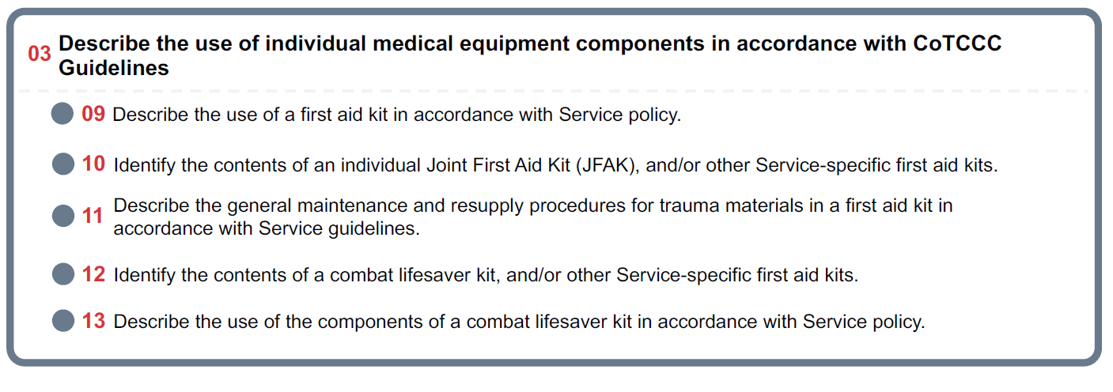







TERMINAL LEARNING OBJECTIVE
STUDENT LEARNING OBJECTIVES
₀₃ Describe the use of individual medical equipment components in accordance with CoTCCC Guidelines
09 Describe the use of a first aid kit in accordance with Service policy.
Identify the contents of an individual Joint First Aid Kit (JFAK), and/or other Service-specific first aid kits.
Describe the general maintenance and resupply procedures for trauma materials in a first aid kit in accordance with Service guidelines.
Identify the contents of a combat lifesaver kit, and/or other Service-specific first aid kits.
Describe the use of the components of a combat lifesaver kit in accordance with Service policy.
5
ENABLING LEARNING OBJECTIVES (ELOs)
= Cognitive ELOs
= Performance ELOs

Slide 4
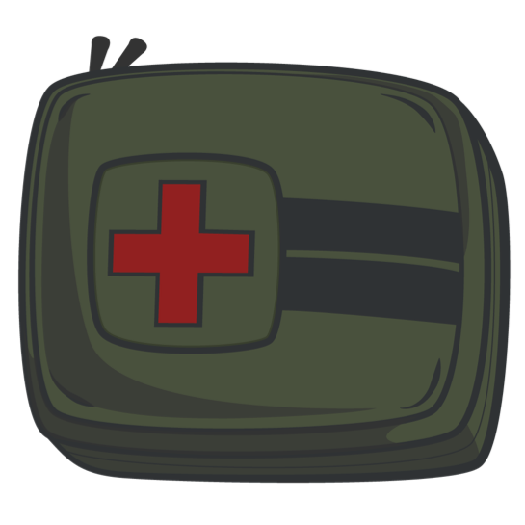
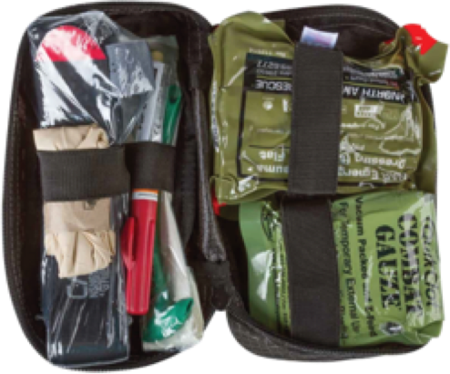
MEDICAL EQUIPMENT
MEDICAL SUPPLIES
WHAT YOU WILL NEED TO PROVIDE AID AND SAVE A LIFE:
BUDDY AID
CLS Bag
INDIVIDUAL
Joint First Aid Kit (JFAK)
BE FAMILIAR WITH YOUR INDIVIDUAL AND SERVICE/UNIT-SPECIFIC MEDICAL EQUIPMENT!

Slide 5
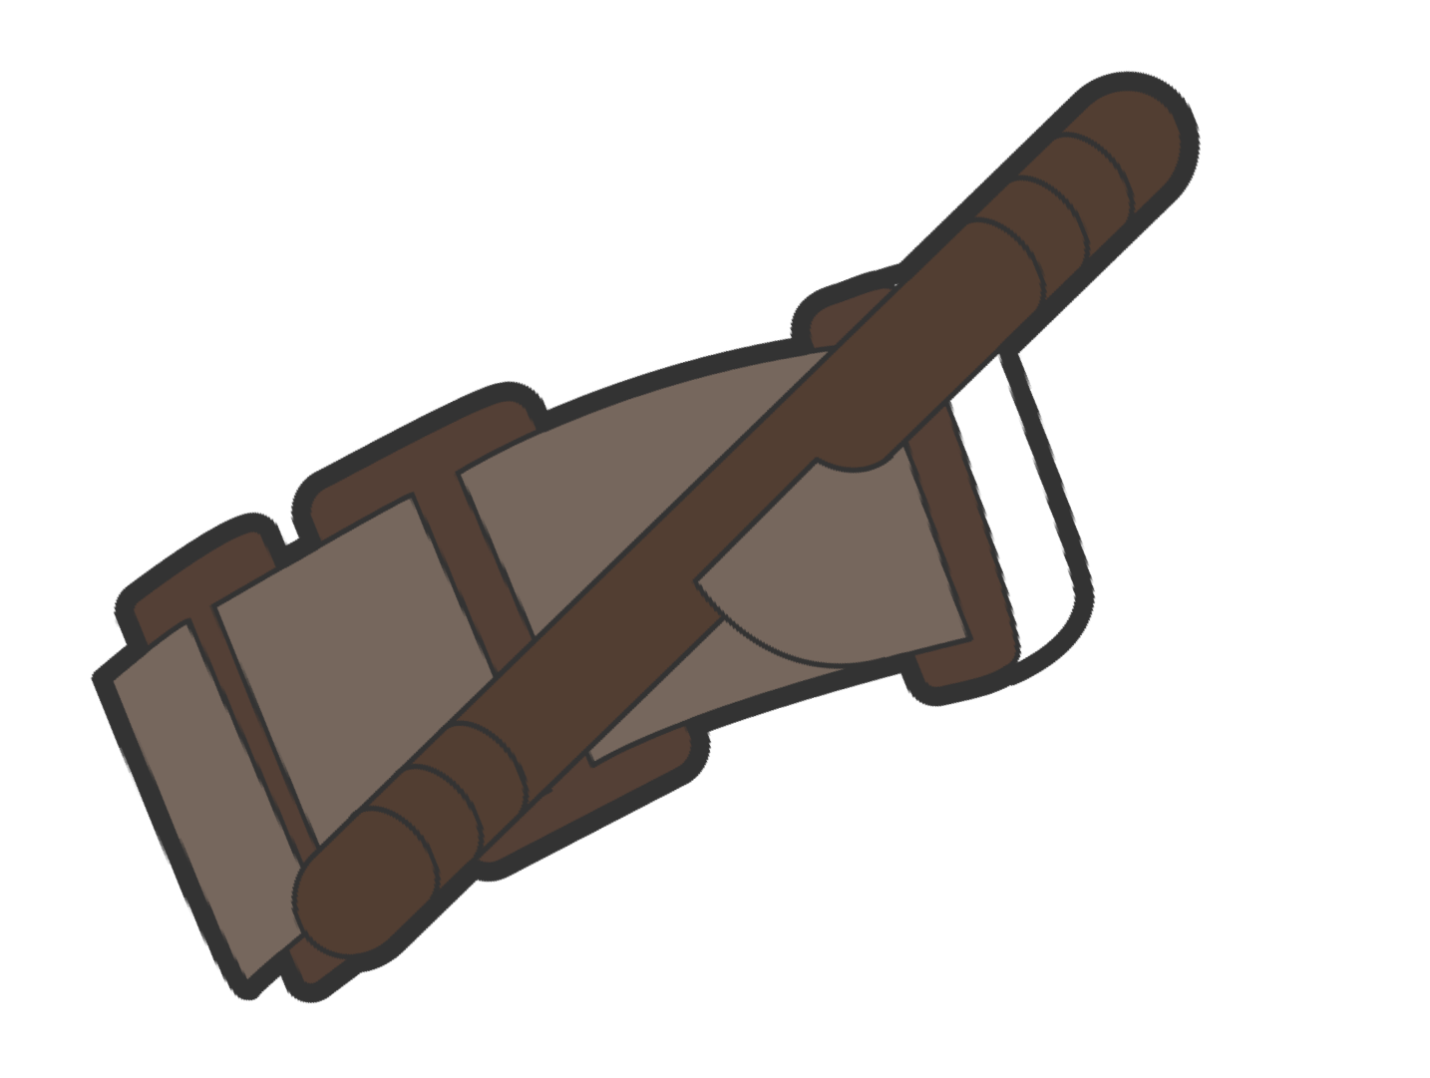
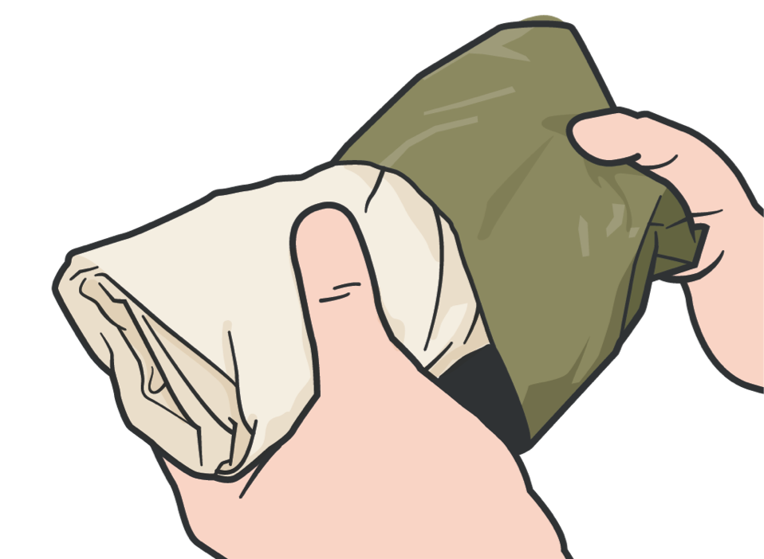
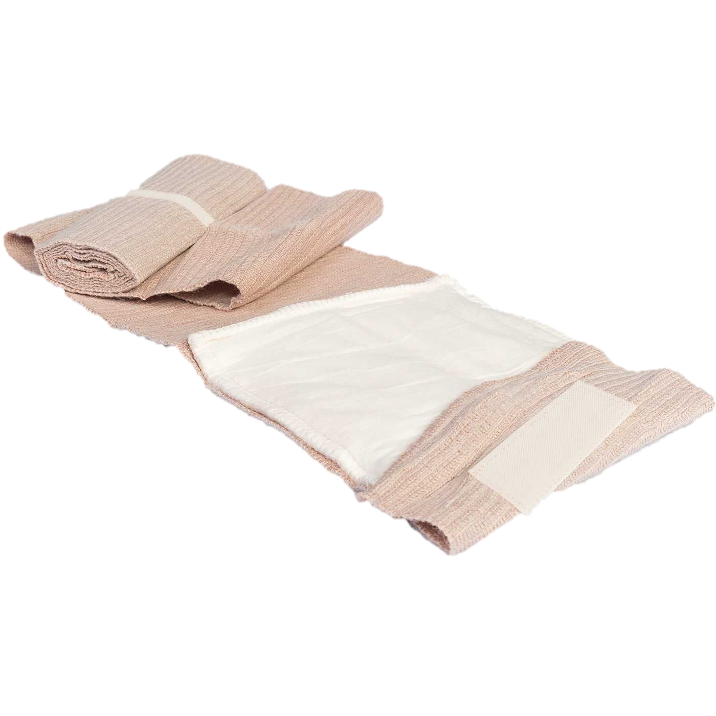
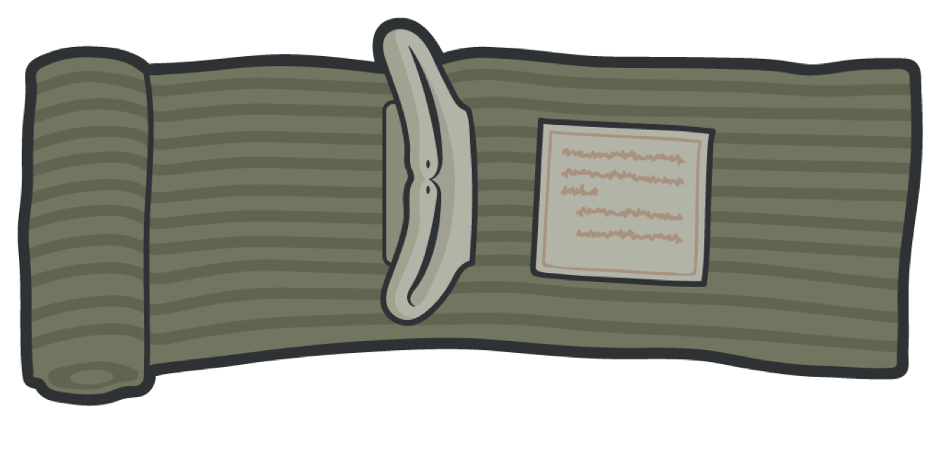
MEDICAL EQUIPMENT
CONTENT OVERVIEW
TOURNIQUET
A device to stop massive
bleeding
HEMOSTATIC GAUZE
Gauze rolls used to stop major life-threatening bleeding
EMERGENCY BANDAGE/ TRAUMA DRESSING
Elastic bandage used as a pressure
dressing and/or standard dressing

Slide 6
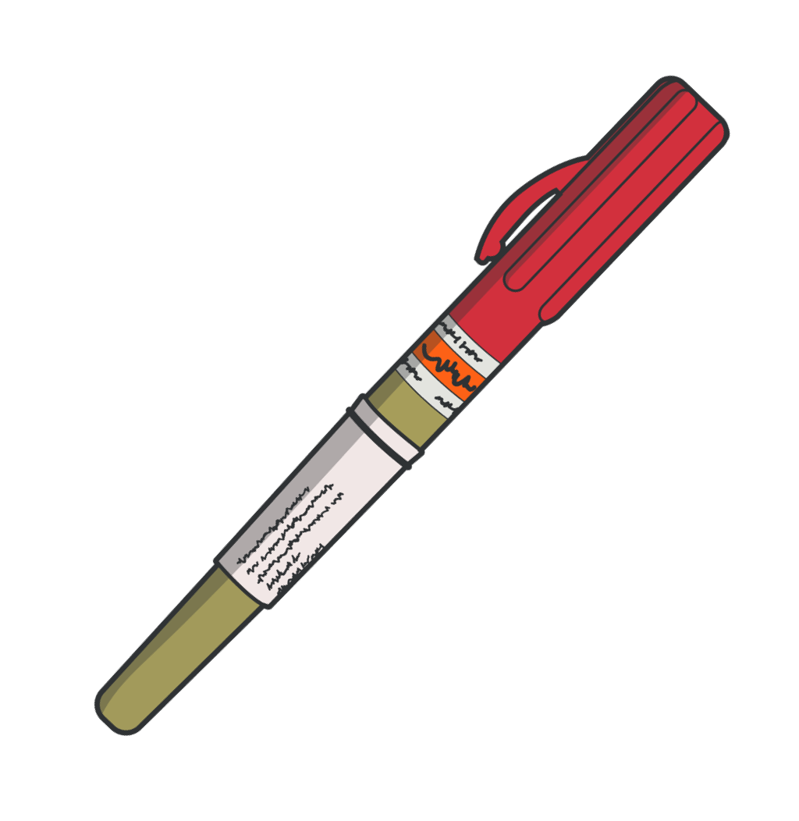
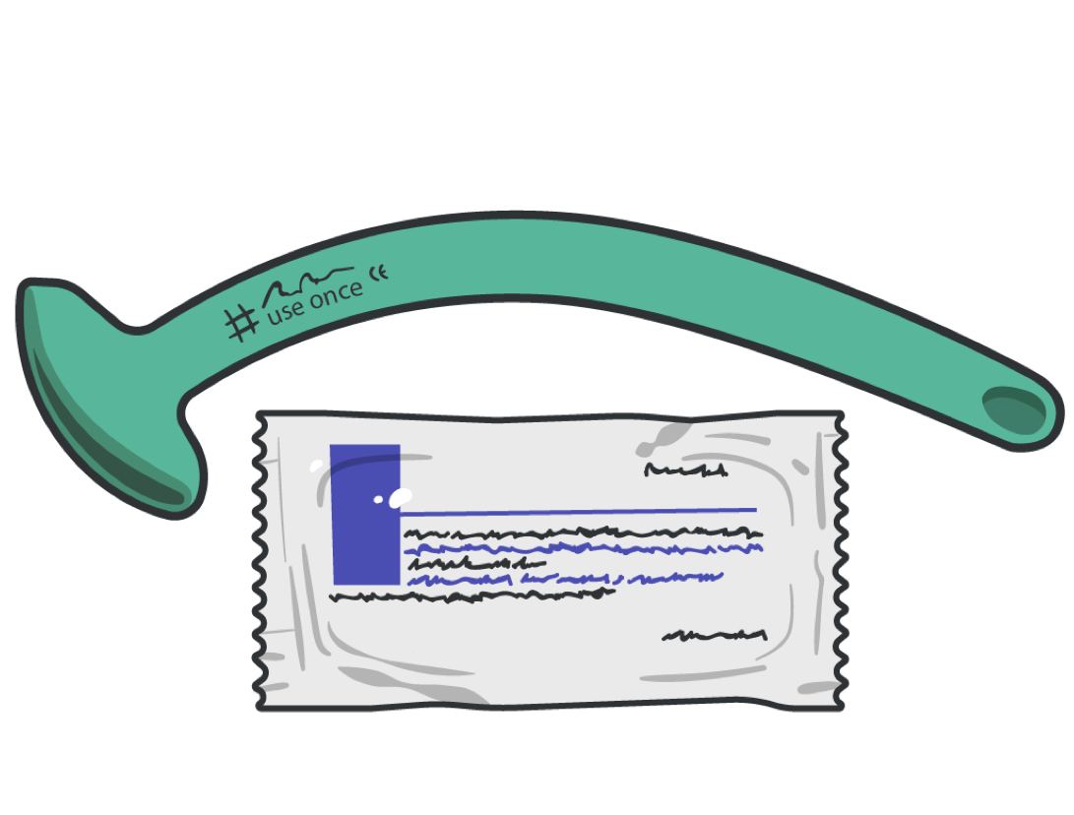
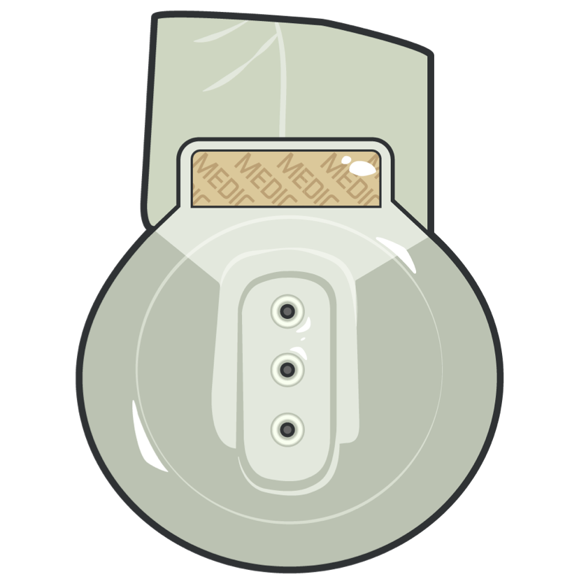

MEDICAL EQUIPMENT
CONTENT OVERVIEW
NASOPHARYNGEAL AIRWAY (NPA) WITH WATER-BASED LUBRICANT
Nonsterile, rubber tube-shaped device that can be inserted into the casualty’s nostril
VENTED CHEST SEAL
Vented and adhesive chest seal for treating penetrating wounds to the chest
NDC 10-14 GAUGE 3.25” NEEDLE CATHETER
Catheter-over-needle device that can be inserted into the casualty’s chest to treat tension pneumothorax

Slide 7
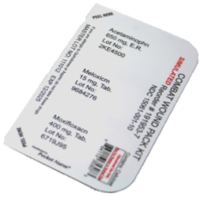




MEDICAL EQUIPMENT
CONTENT OVERVIEW
Acetaminophen 2x 650mg capsules
1
2 Meloxicam 15mg tablet
3
1
2
3
Moxifloxacin 400mg tablet
NOTE:
Each of the three medications (in unit dosages) is contained in a single blister pack
The Combat Wound Medication Pack (CWMP) should be used ONLY for traumatic injuries and ALL penetrating injuries.
The CWMP may be procured through medical logistics systems or may be locally packaged by medical personnel

Slide 8
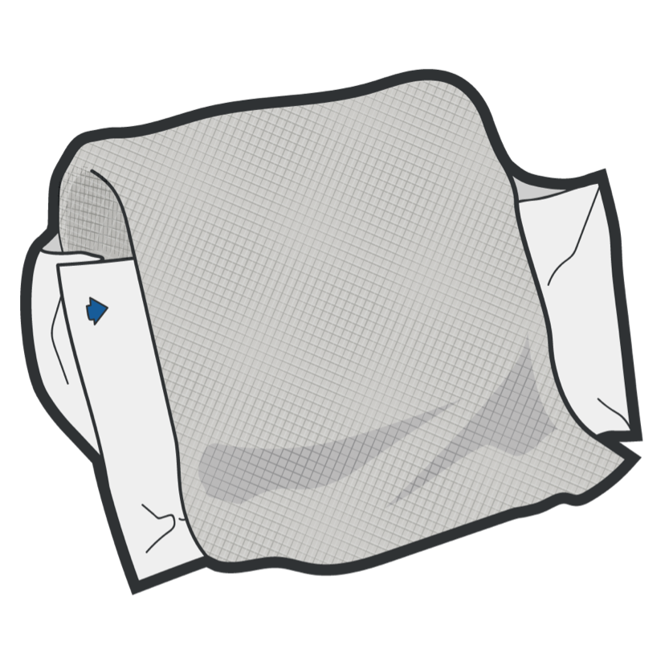
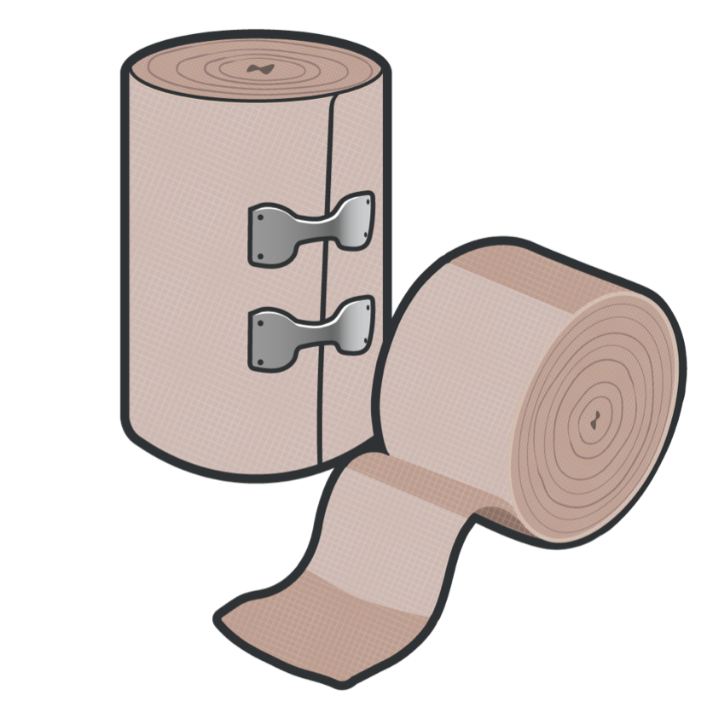
MEDICAL EQUIPMENT
CONTENT OVERVIEW
GAUZE/PACKING DRESSING
Gauze rolls used to stop minor bleeding or as bulky material for packing wounds
ELASTIC BANDAGE
Stretchable bandage that creates localized pressure used for pressure dressings

Slide 9
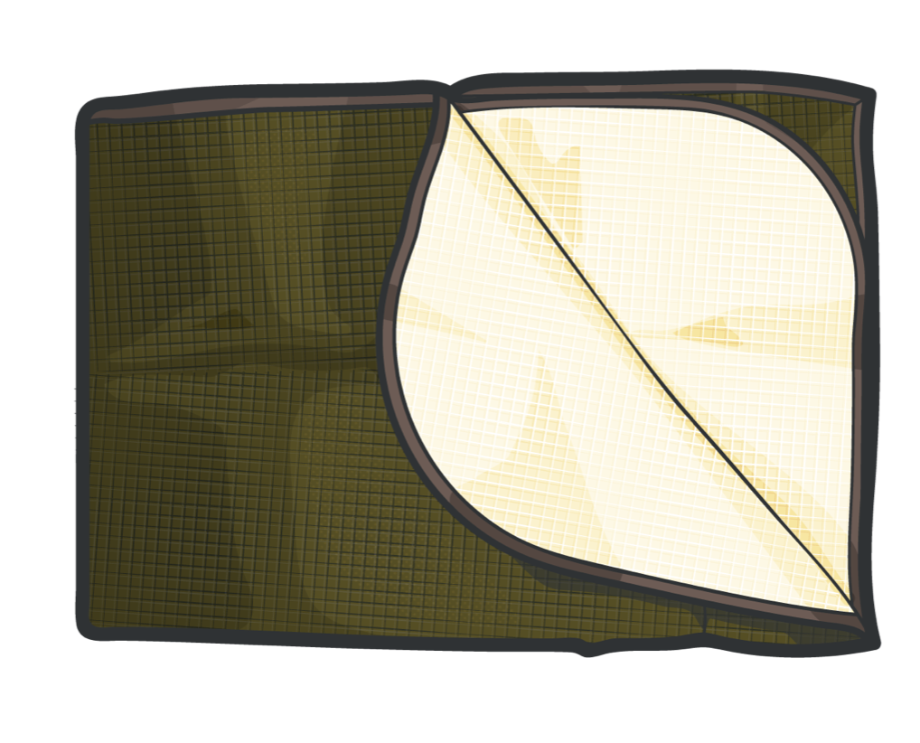
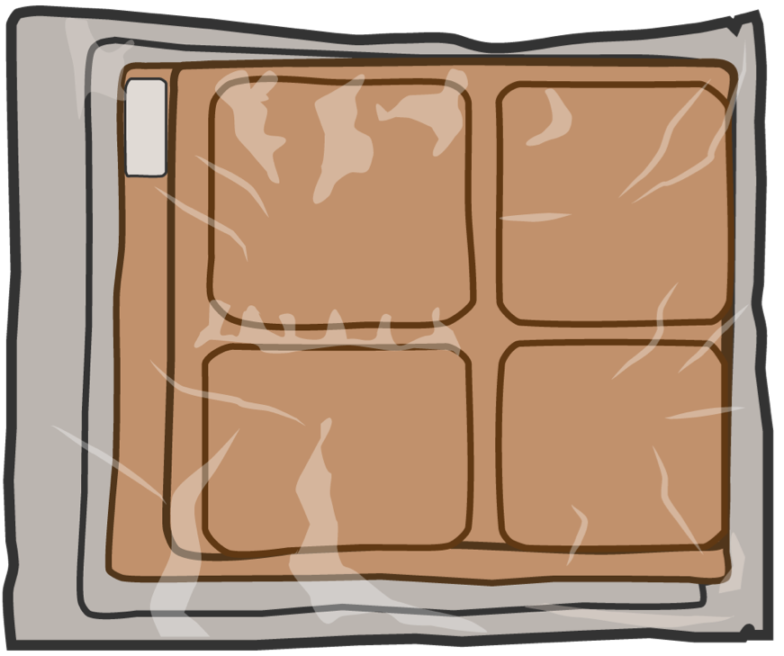
MEDICAL EQUIPMENT
CONTENT OVERVIEW
ACTIVE
PASSIVE
ACTIVE/PASSIVE HYPOTHERMIA BLANKET
Used to prevent and manage hypothermia

Slide 10
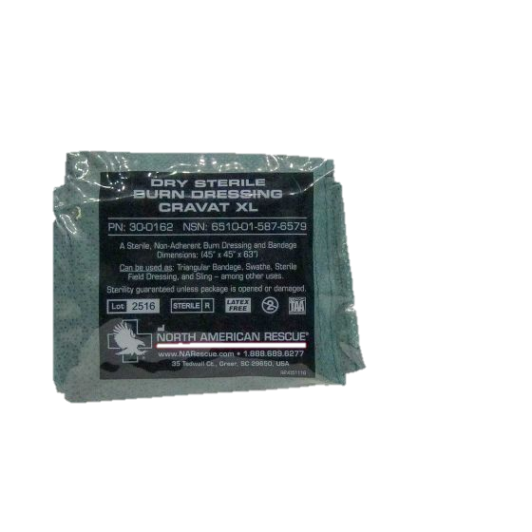
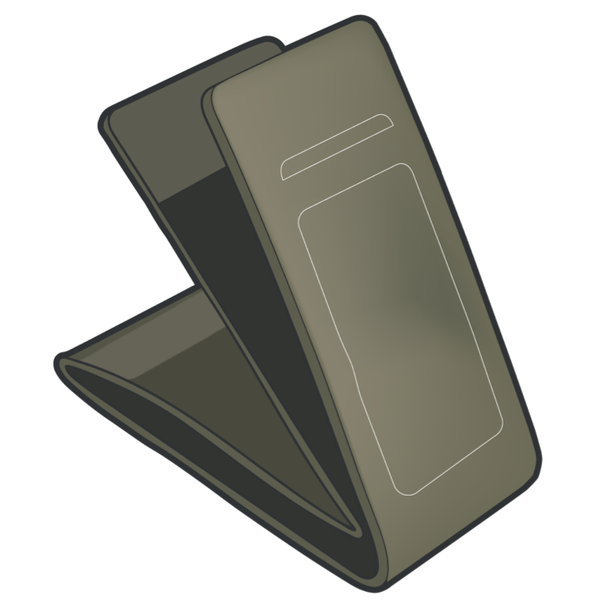
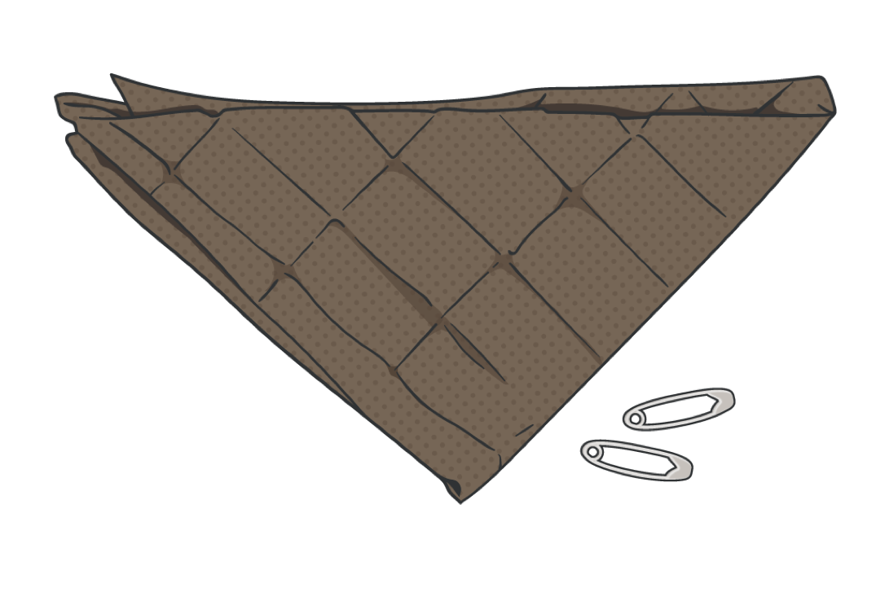
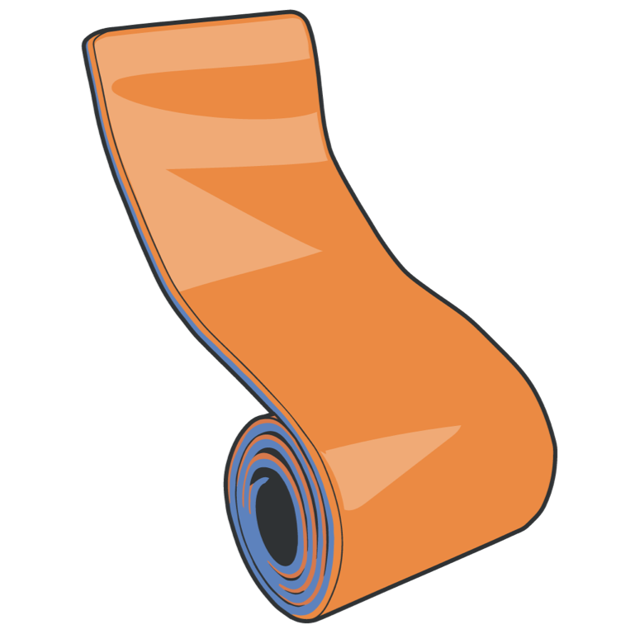
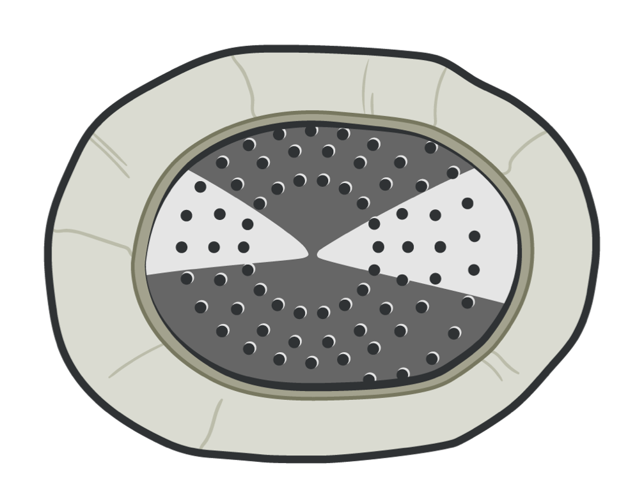
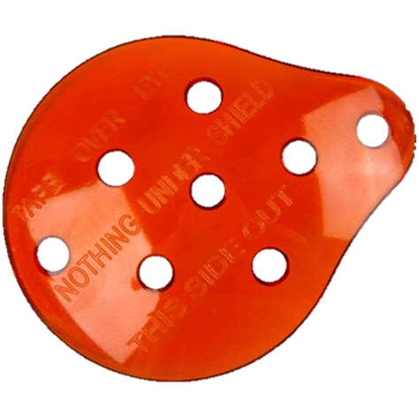
MEDICAL EQUIPMENT
CONTENT OVERVIEW
MALLEABLE SPLINTING
Semirigid material that can be formed to the injured limb to assist in immobilizing
DRY STERILE CRAVAT
Non-Adherent Burn Dressing can be used as a triangular bandage, swathe, sterile field dressing and sling used to assist in immobilizing the injured limb or protrusion, among other uses
RIGID EYE SHIELD
A shield that provides a domed protection of eye injuries WITHOUT applying pressure

Slide 11

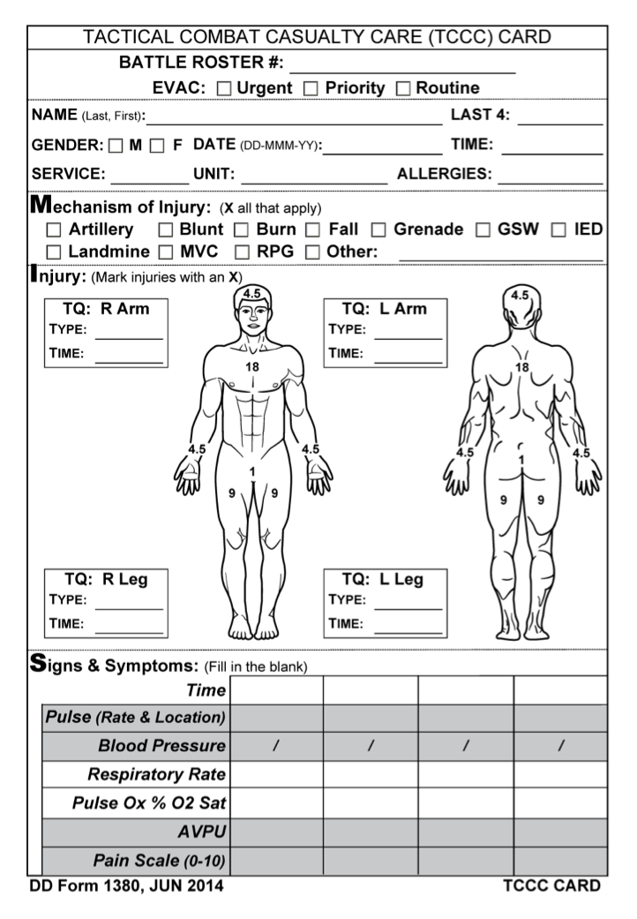
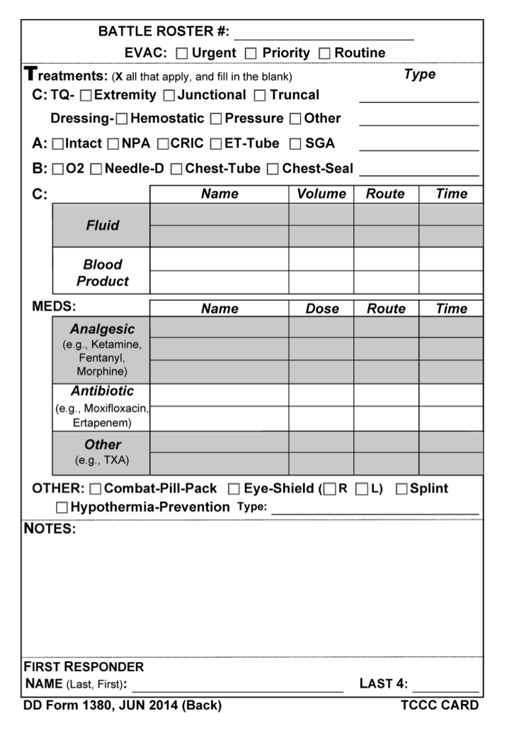
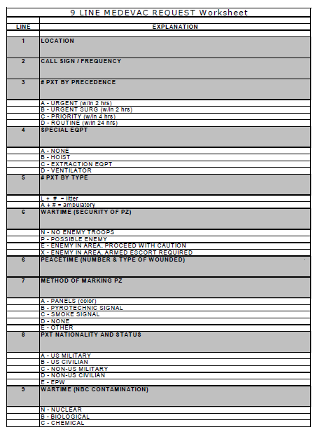
MEDICAL EQUIPMENT
DOCUMENTATION
FRONT
BACK
9-LINE
Call procedure that is divided into 9 lines of information for evacuation crews
DD Form 1380 TCCC CARD
DoD-approved standard for documenting ALL assessment and treatment provided to casualties before evacuation or handoff to medical personnel

Slide 12
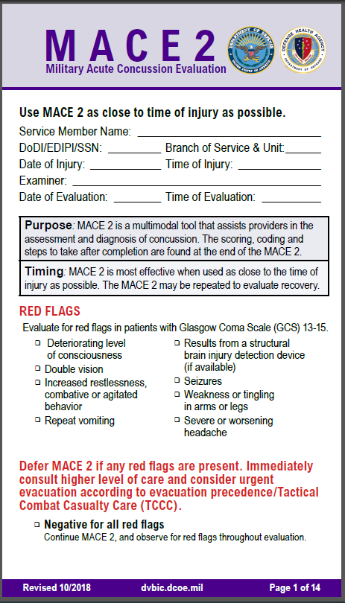
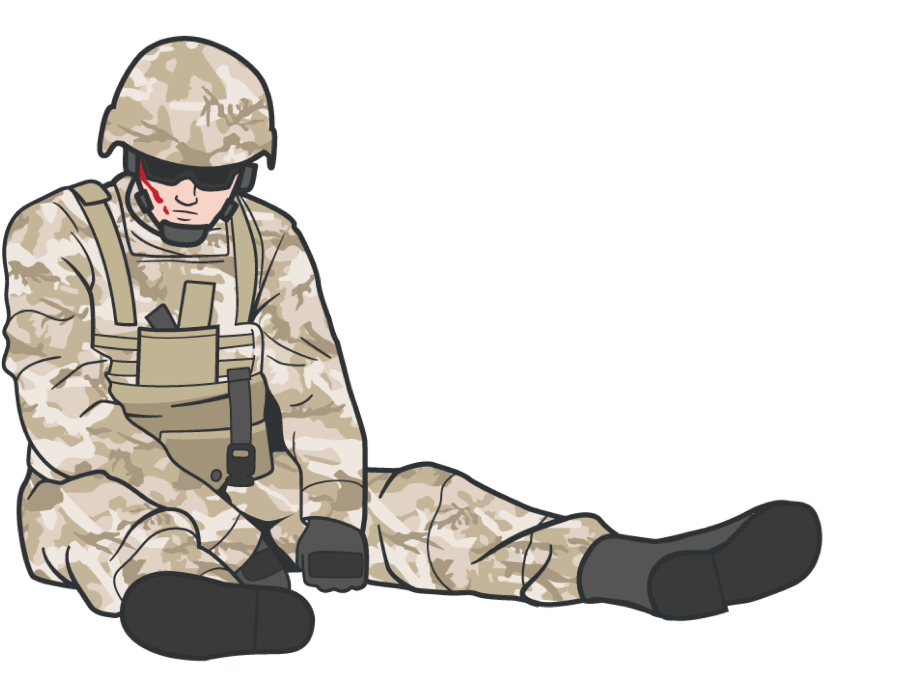
MEDICAL EQUIPMENT
DOCUMENTATION
MILITARY ACUTE CONCUSSION EVALUATION (MACE2)
Used for identifying possible traumatic brain injury (TBI)

Slide 13
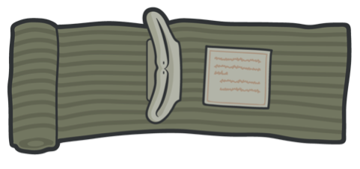
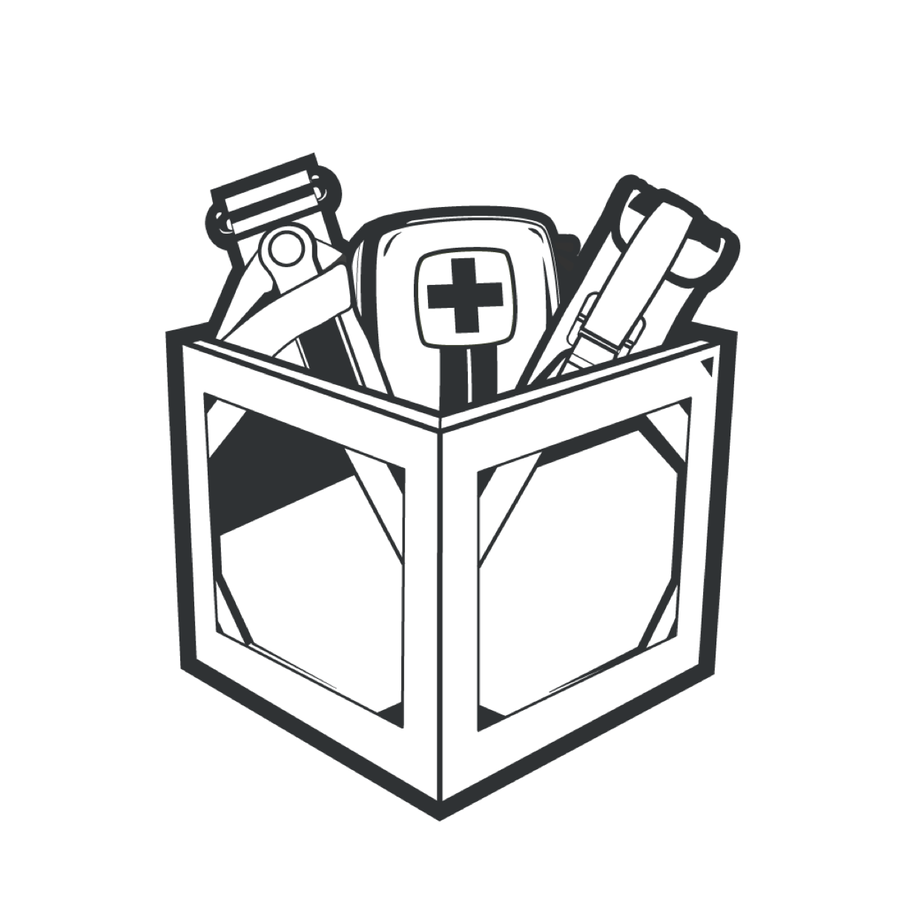
MAINTENANCE AND RESUPPLY
MEDICAL EQUIPMENT
REMEMBER:
Regularly inspect your JFAK, CLS Bag, and other service-specific medical kits:
BEFORE
DURING
AFTER
ALL training events and missions

Slide 14
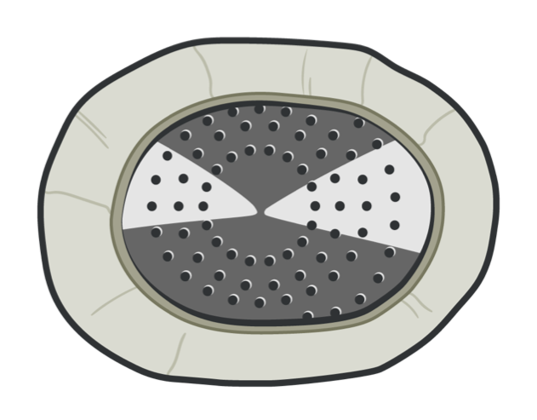

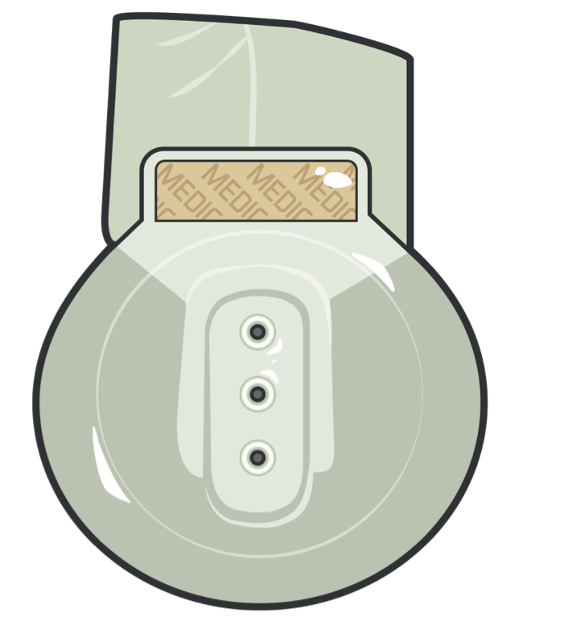
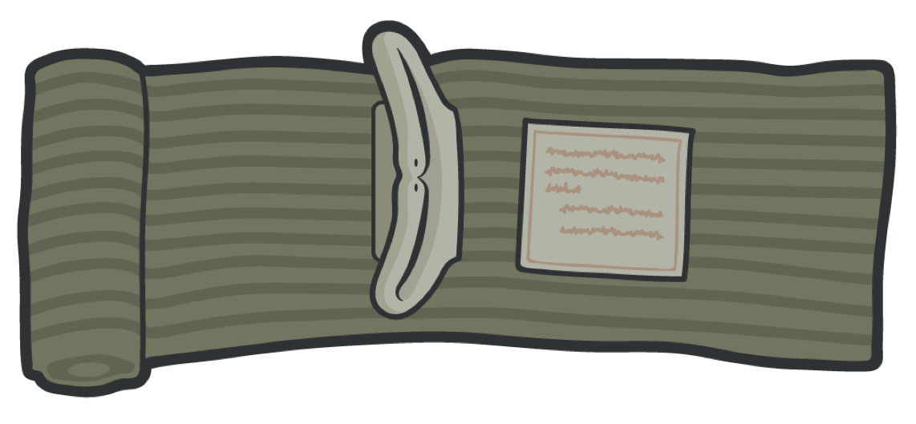

MEDICAL EQUIPMENT
MAINTENANCE AND RESUPPLY
Check to be sure all equipment is in the kit Check seals and wrappers
REPLACE items with broken or unsealed wrappers
Check expiration dates
REPLACE if expired or the expiration date DOES NOT exceed your expected deployment timeframe
BEWARE OF FAKES/EQUIPMENT THAT IS NOT COTCCC APPROVED!
DO NOT DEPLOY WITH MISSING, PREVIOUSLY USED FOR TRAINING, OR EXPIRED EQUIPMENT

Slide 15
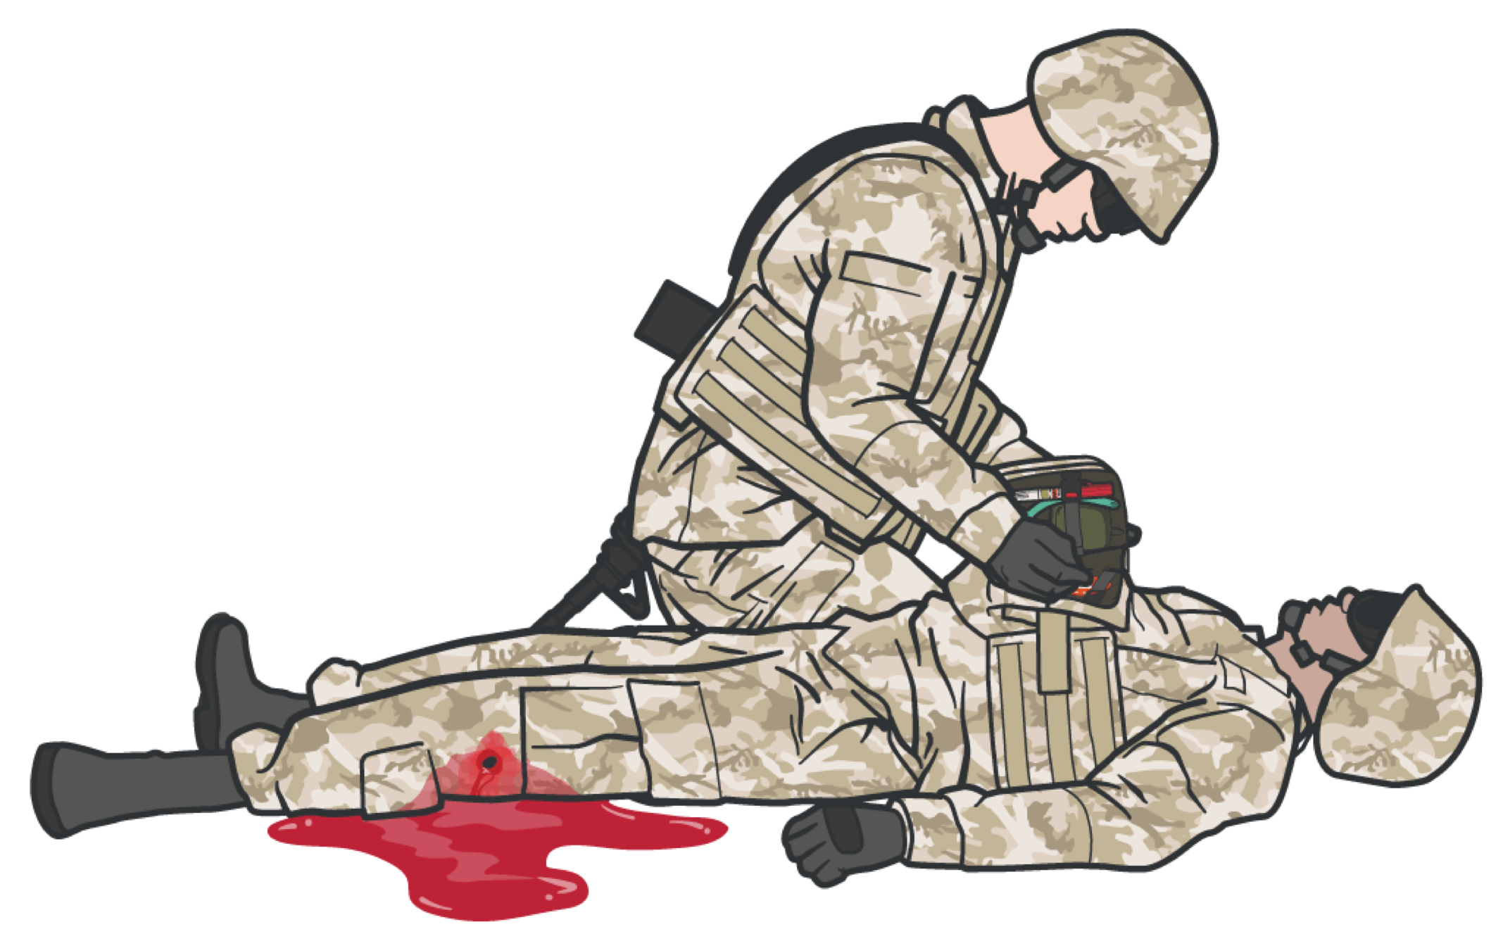
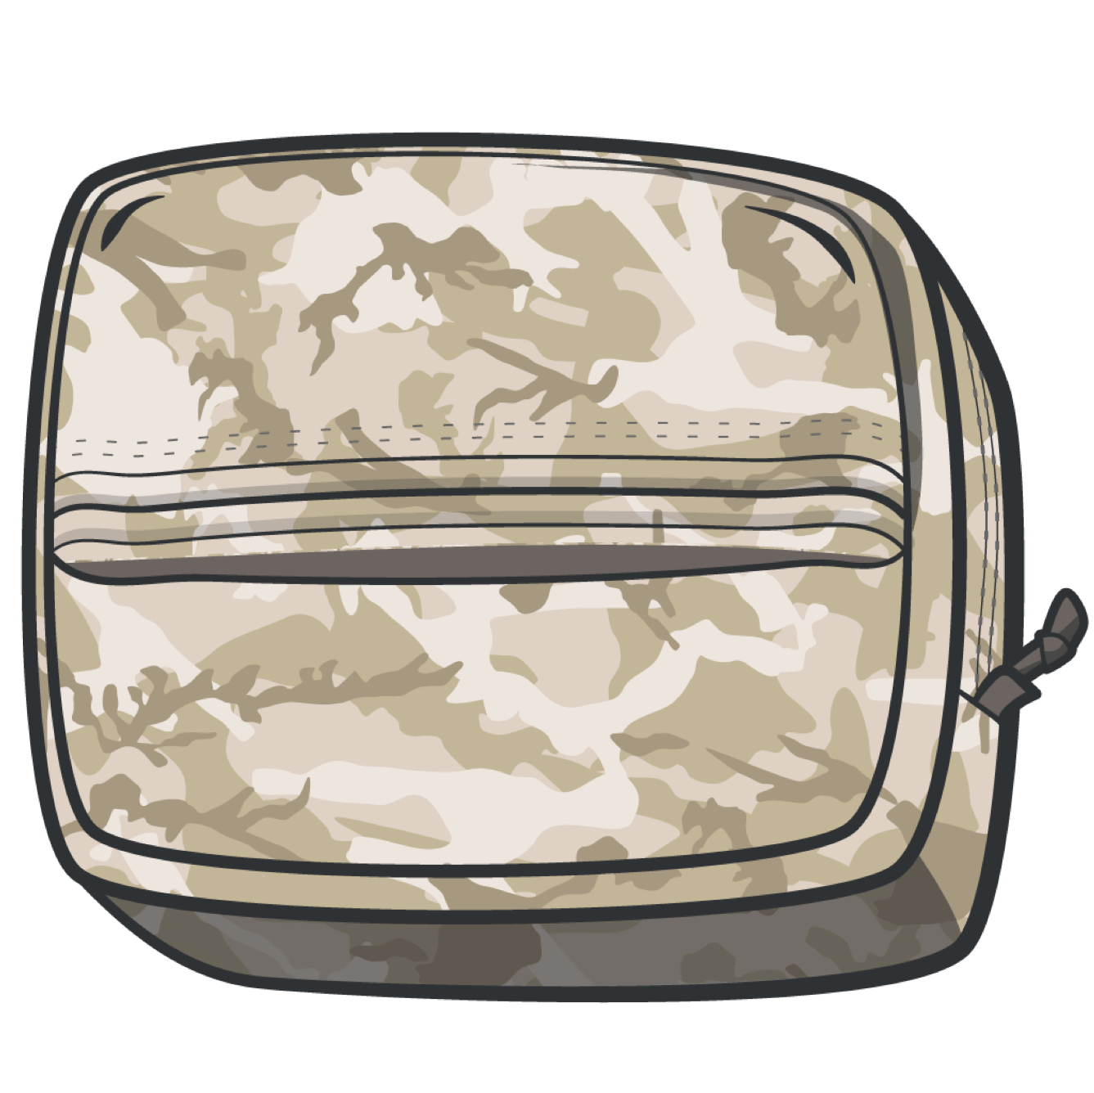
CLS KIT
Always use the casualty's JFAK first
CLS Kit
When supplies are exhausted from the casualty’s JFAK, resort to using supplies from the CLS kit.
15

Slide 16
SKILL STATION
Familiarization with JFAK and CLS Kit
16

Slide 17
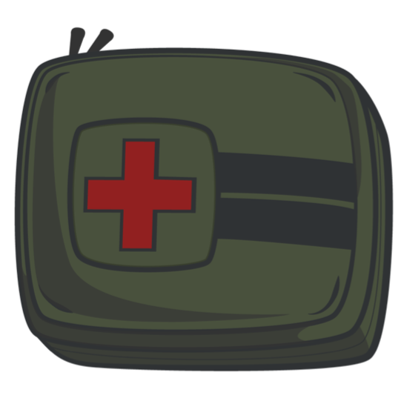

MEDICAL EQUIPMENT
SUMMARY
Familiarize yourself with the content of the CLS bag and JFAK.
Ensure you are aware of the resupply procedures and how to maintain your equipment.
Regularly inspect your JFAK, CLS Bag, and other Service-specific medical kits:
BUDDY AID
CLS Bag
BEFORE
DURING
AFTER
INDIVIDUAL
Joint First Aid Kit (JFAK)
ALL training events and missions.
Be sure to use proper documentation when needed; MACE2, 9-Line, and DD Form 1380.
17

Slide 18



CHECK ON LEARNING
When providing “buddy aid,” should you use your JFAK or the casualty’s JFAK?
What is the most important lifesaving item in the JFAK?
When should medications and medical-grade equipment be replaced in the JFAK?
18

Slide 19
ANY QUESTIONS?
19

